Slide 1
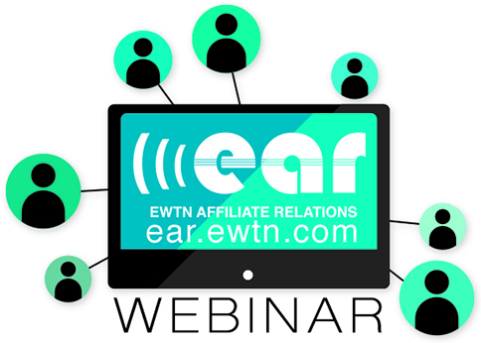

Slide 2
On-Air Pledge Drives, Part 2
Toya Hall
Guadalupe Radio

Slide 3
Pledge Drives
Mother Angelica said, “Never put a lid on God. You can give God a thimble and ask for a quart. It won’t work. Your plans, your projects, your dreams have to always be bigger than you, so God has room to operate. I want you to get good ideas, crazy ideas, extravagant ideas. Nothing is too much for the Lord to do-accent on ‘The Lord’.”
The Foundation to a Successful On-Air Fundraiser

Slide 4
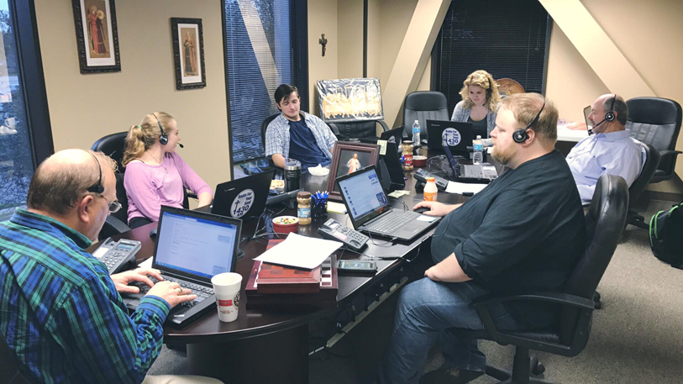
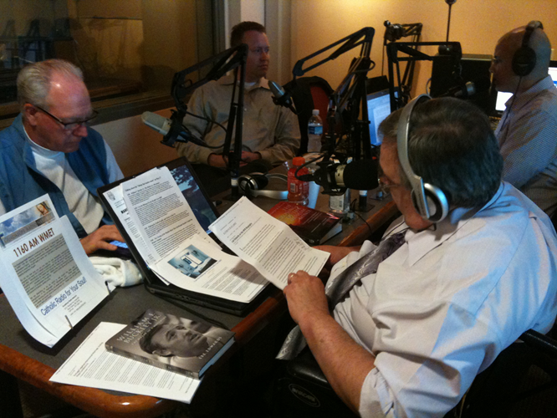
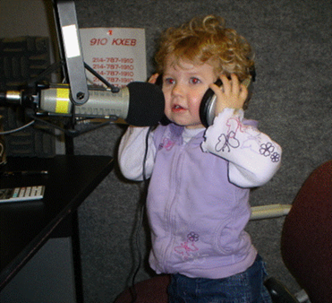
Planning 6 Weeks Prior To Pledge Drive

Slide 5
Getting Organized
Create Excel Workbook for Pledge Drive
GRN Prayer Schedule, Contact Religious Orders
Develop Theme
Create Talking Points
Call All Donors With Fulfilled Pledges 1 Week Out
Hourly Guest Scheduled And Prerecorded Testimonials Created
Schedule Call Center Volunteers and Gifts
Schedule Donated Meals For Volunteers And Staff

Slide 6
Planning Ahead
Radio Promo Spots Begin 2 Weeks Out
Setup Phone Lines And Prepare Website
Set Hourly Clocks
First And Last Hour A Music Break At The Bottom Of The Hour
All Other Hours 5 Minute Break 20 minutes After The Hour And 5 Minute Break 20 Minutes Until The Top Of The Hour
Prerecorded Segments Play in the 5 Minute Breaks
Create Thank You List For On-Air Mention At The End Of Pledge Drive

Slide 7
What Drives A Pledge Drive?
Raising Matching Gift Funds For 50% Of Overall Goal
Setup Giving Levels
$10+ Monthly Pledge – Angel
$30+ Monthly Pledge – Guardian Angel
$1,500 One-Time or $125 Monthly – Archangel
$5,000 One-Time – Seraphim Angel
Order Appreciation Gift For Angel Level And Up
Order NFP Gift
Raise Funds For Daily Appreciation Gift Drawing
Arrange Pilgrimage Drawing For Archangel Donor Level

Slide 8
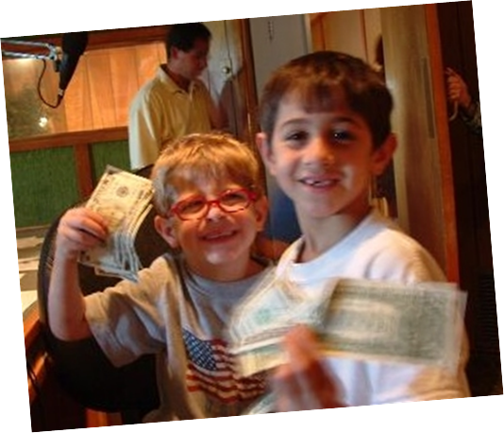
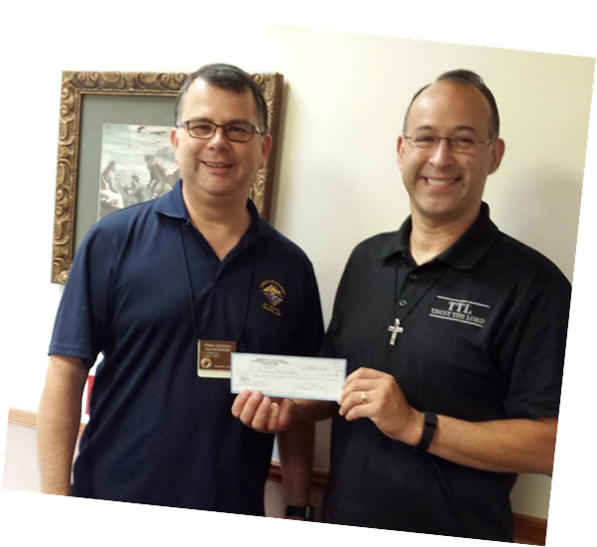
Matching Gifts
Underwriters
Individual Major Donors
Parish And Catholic Organization Donations
Special Event Donations
Contingent Matching Gifts

Slide 9
Content: Sounding Fresh Every Hour
Keep In Mind On Average The Turn Over Of A Radio Audience Is Possibly 8, 10, or 15 Minutes At Best For The Vast Majority Of Those Listening. So, You Have A New Audience Three Times An Hour!
Make Sure That Each Testimony Is About The Power Of Catholic Radio
Change Out Hosts And Guests Every Couple Of Hours
Be Creative And Figure Out How To Say The Same Thing But In A Different Way. Being Entertaining Keeps The Sound Fresh.
Keep The Mindset That This Is The First Time The Listener Has Heard Your Story or Pitch.
Celebrate At The End Of Each Hour When You Meet The Goal. Develop A ‘Prayer Of Celebration’ To Say When Each Goal Is Met For Those Donors.

Slide 10
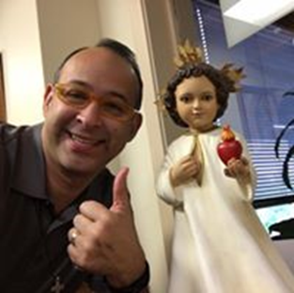
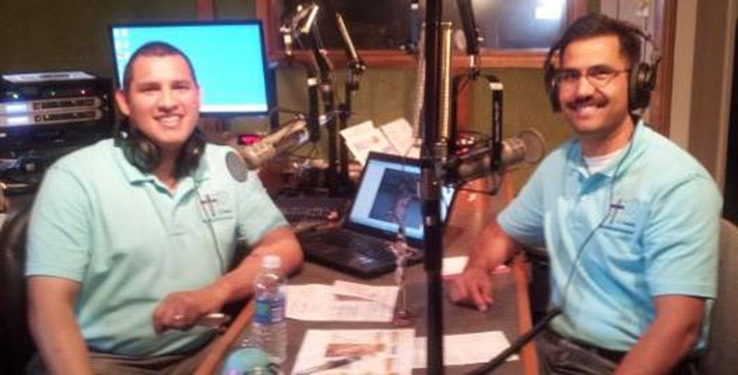
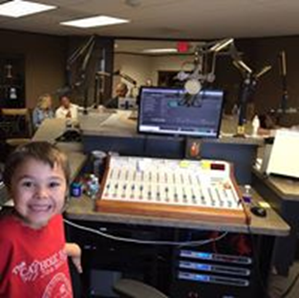
KEEPING THE PLEDGE DRIVE ENERGIZED

Slide 11
On Air Delivery
Joy, Peace and Calm Affect The Listener In A Positive Way.
Smile-When You Smile Your Voice Smiles And It Comes Across More Appealing And Personable To The Listener.
Think Of Speaking On The Radio As An Intimate Conversation With A Friend And Not A Conversation With Thousands.
People Listen To The Radio To Get Away From Their Troubles, Lighten Their Day, Enrich Their Faith, To Hear Another Voice, Hear Some News And To Be Entertained.
Be Yourself, Not Your Favorite Radio/TV Personality.
Inside Jokes Alienate Listeners.
Let The Listener Get To Know You Personally. This Is Where Relationships Are Forged.

Slide 12
Interviews And Testimonies
Quality Trumps Quantity, So It’s Better To Have A Dozen Amazing, Life-Changing Stories Than Dozens Of Mediocre Ones. Your Audience Is Turning Over Frequently So Stick With The Best Of The Best, Even If It Means You Repeat Recorded Testimonies.
Make Sure that Each Testimony Is About The Power Of Catholic Radio.
Get Creative And Figure Out How To Say The Same Thing But In A Different Way.
Keep The Mindset That This Is The First time The Listener Has Heard Your Story Or Pitch.
Post On Facebook/Text How The Hour Is Going

Slide 13
The Appeal
A Compelling Appeal States The Case For The Value Of The Ministry And The reason To Support It.
Three Things That Should Happen Each Hour:
Testimony
A Listener Story That Gives Evidence To The Impact of The Ministry Is The Most Credible Case For Support
Incentive: A Strategically Placed Incentive Such As:
Matching Gift Hour
Contingent Matching Gift
Long-Term Or Short-Term Goal Hour
Call-To-Action
A Sense Of Urgency In Your Appeal
Make It Easy For People To donate

Slide 14
During & After The Pledge Drive
During Pledge Drive Call Major Donors Within One Hour Of Their Pledge
During Pledge Drive Draw The Winner Of The Daily Appreciation Gift
During Pledge Drive Send Out An Email Blast Each Evening Letting Everyone Know How The Drive Is Going, Seek Their Prayers, Ask That They Promote The Drive And Pray For The Drive
Contact Seraphim Donors To Schedule Live Remote
Order The Winners’ Daily Appreciation Gift
Call Matching Gift Donors To Thank Them And Let Them Know How Their Gift Was Matched
Send Thank You Cards To Major Donors
Send Thank You Cards To Volunteers
Make Sure Everything Is Ready For Mailing ASAP
Have Materials Already Packaged In Mailing Envelopes Prior To Pledge Drive
Enlist Extra Help If Necessary To Make Sure Mailing Is Done Within A Week Or Less

Slide 15
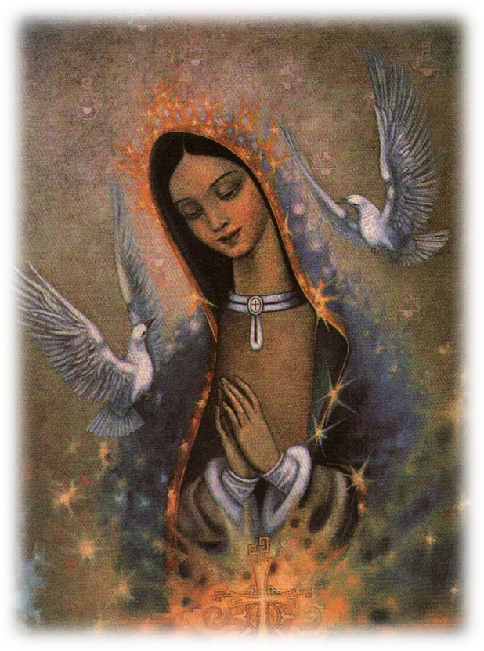
Give Thanks
“In All Things Give thanks; For This Is The Will Of God In Christ Jesus Concerning You All.” 1 Thessalonians 5:18
Send Out An Email Blast Thanking Everyone For Their Support
Post A Thank you to everyone On Facebook
Run On Air Spots Thanking All The Prayer Warriors And Benefactors
Most Of All Take time To Give Thanks For The Pledge Drive. Pray In Thanksgiving For The Benefactors, Volunteers And Staff And For The Many Blessings That Our Lord And Blessed Mother Have Bestowed.

Slide 16
Questions?

Slide 17
Contact Toya
toyahall@grnonline.com
432-682-5476

Slide 18
Upcoming Webinars
Thursday May 4 4:30eT/3:30CT
Planning for the Next Pledge Drive
Jim Carroll, Spirit Catholic Radio

Slide 19
If you haven’t already, be sure to check out our EWTN Affiliate Relations Website
ear.ewtn.com

