Slide 1
"Effective Website for Catholic Radio" The 5-4-3-2-1

Slide 2
5 Points to the Best web site
Logo & Monger Branding
Clean and Easy to Navigate | Desktop & Mobile
Updated Schedule & Host/Staff Photos
Display social media icons
The more Interactive the better!

Slide 3
4 Key Objectives
Engaging with the audience Providing information about shows, guests, topics & schedules Promoting events and contests
Streaming live radio

Slide 4
3 Should I Stay or Should I Go
It takes about 50 milliseconds for users to form an opinion about your website that determines whether they stay or go
2.6 seconds for a user’s eyes to land on the area of a website that most influences their first impression
Make sure your website is well designed and well structured from start to finish

Slide 5
What NOW?
If it’s been 2 or more years to update your site, now’s the time to do it
If you can’t overhaul then take inventory of your site on the things we discussed
Fix what’s broken

Slide 6
And in at #1
The Web site is your ramp for new listeners and a ramp for ALL the things you mention & don’t mention on the air

Slide 7
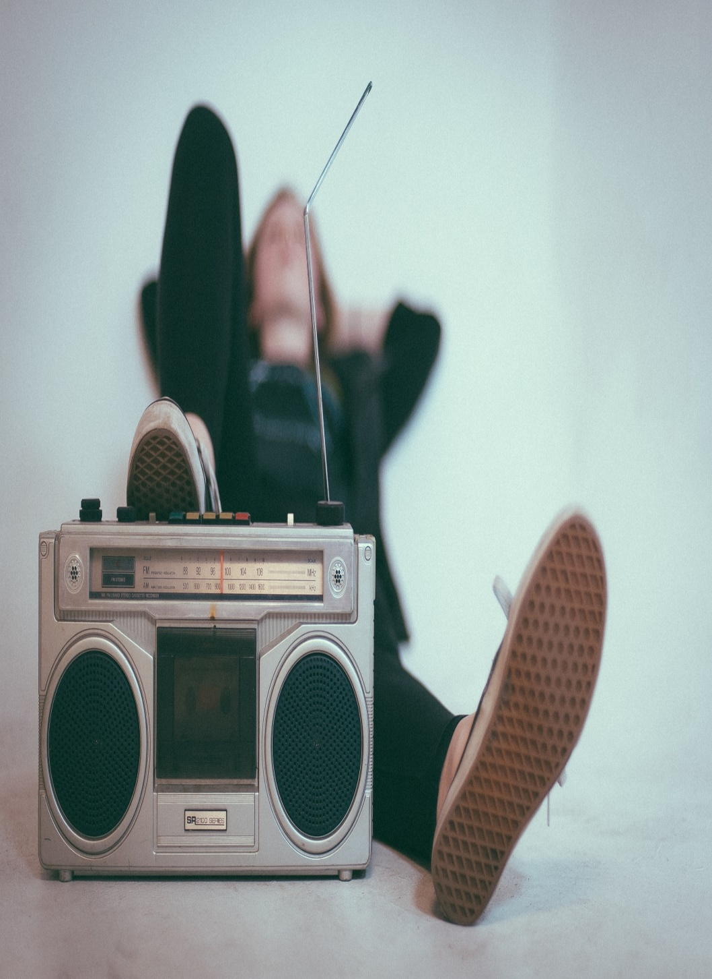
Bonus Cuts: Building Community
Contest Giveaways
Meet N Greets
Online Bible Study
Make the audience feel like they are a part of something special and valued.

Slide 8
Ace Picks The Hits
The Quest
The Rock
Guadalupe Radio Network

Slide 9
EMAIL: amckay@ewtn.com

